Slide 1
Breaking into Cyber
Where the hell do I start?

Slide 2
Target Audience
If you have several years of experience in the industry, this talk is not for you. This talk is for people who want to get started in the field, primarily students

Slide 3
The best advice I can give
Don’t get overwhelmed
Learn by piece, don’t dive into everything all at once
Be patient

Slide 4
What Kind of Computer Do I Need?
It depends.
I Recommend a quad core cpu with at least 8Gb of RAM

Slide 5
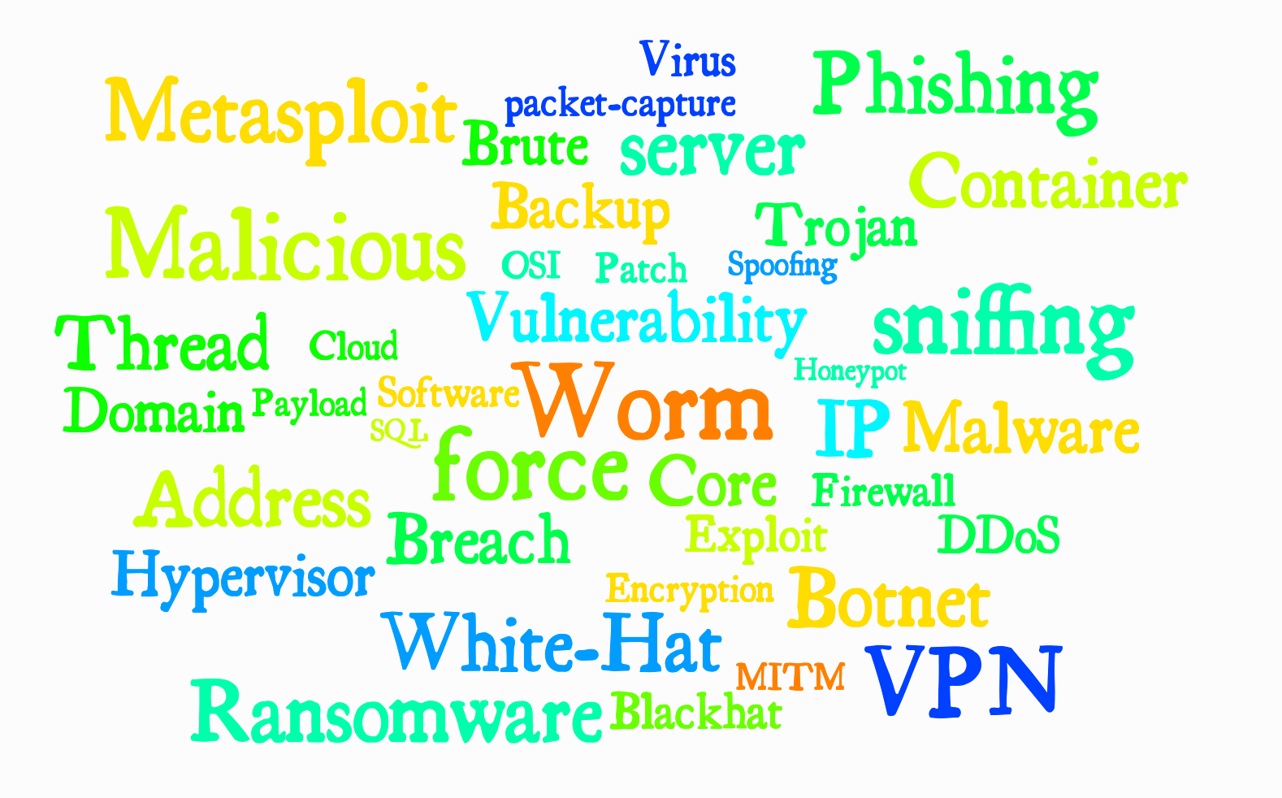

Slide 6
The Basics
How to computer.
Learn how to use a terminal
OSI Model
Learn how applications work
Networking
Learn how it’s all connected
Virtualization
Learn how to simulate environments

Slide 7
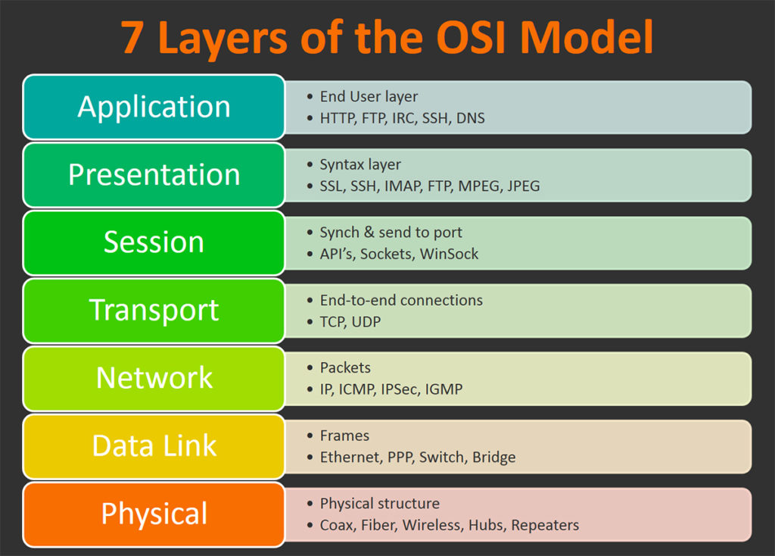

Slide 8
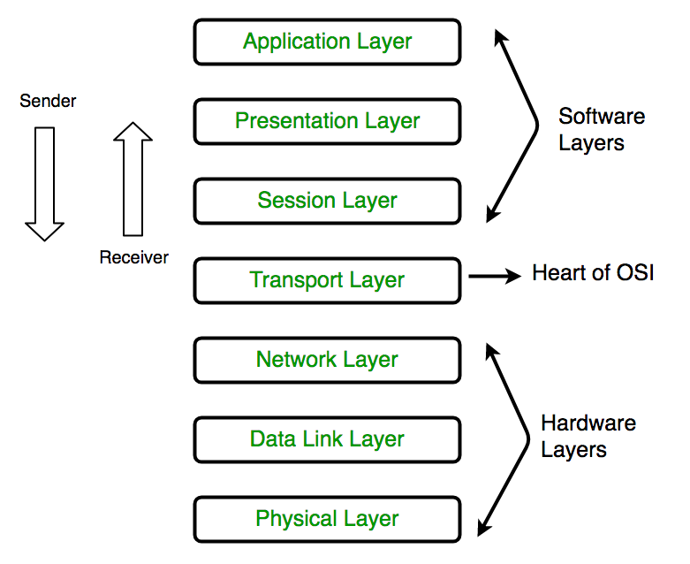

Slide 9
Networking: The Basics
IP Address: Software Address
MAC Address: Hardware Address
Ports: A meaningless number: identifies one side of a connection between two computers
Protocols: Standardized forms of communication TCP: Connection, handshake
UDP: Packet vomit

Slide 10
Virtualization
Hypervisors:
Type 2
Pros: “On metal”, faster
Cons: Requires dedicated hardware
Examples: ESX, Xen
Type 3
Pros: runs on your host, only need one computer
Cons: super slow, eats up lots of space
Examples: Fusion, Virtualbox
Containers shut up I know it’s not technically a hypervisor
Pros: very fast, lightweight, premade, super easy to use
Cons: Not “real” vm’s, more difficult to understand

Slide 11
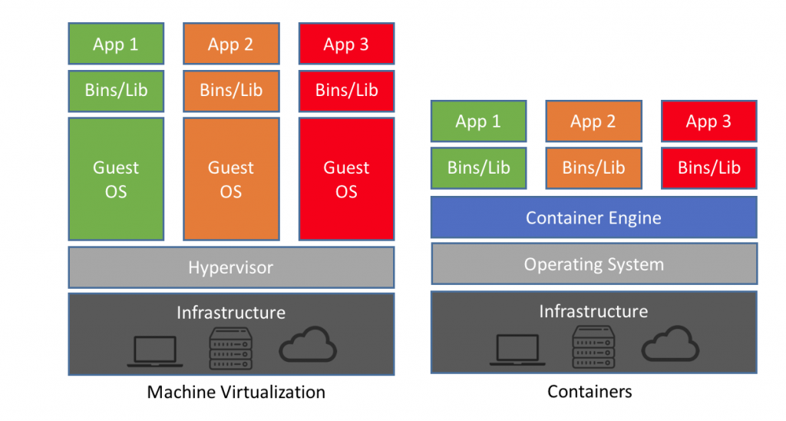

Slide 12
Containers - Yes it’s that easy
https://hub.docker.com/r/vulnerables/web-dvwa/
You can spin up machines to play with in one line
They’re very fast & take up very little space

Slide 13
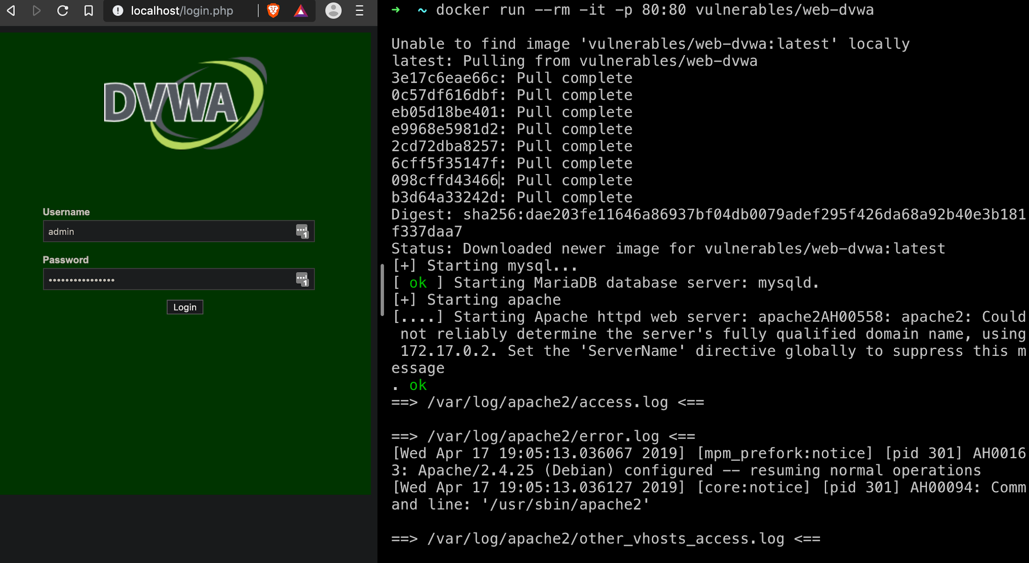

Slide 14
The Intermediate
Pick a team
Red Team: Bad guys
Simulated attackers
Blue team: Good guys
Incident response
Forensics
Network security

Slide 15
RECON IS IMPORTANT
The most important thing in cyber, regardless of red or blue is visibility
Tools
Nmap
Openvas

Slide 16
The Advanced
Reverse Engineering & Payload Development
Taking stuff apart is hard, but you’ll know how it works

